Slide 1


AI & Robotics
Free Workshop
For
Indus Valley
Make India
an AI
Super Power
IoT, Robotics
& AI Study
IT
Competency
nodiam, Education that enlightens!
Dependable Competency Partners
Expert Industry Veterans
Lucid & Practical
Scientific
Knowledge
nodiam – Private & Confidential – 2023 ©

Slide 2

nodiam’s Extensive Package
nodiam’s mission is to mentor school children into leading edge technologies because children’s appreciation for technology today, will make India the leader of tomorrow.
Our globally industry leading coaches specialize in:
Comprehensive teaching of Robotics & AI board curriculum
Python computing skills & all relevant libraries
Data Science, Analytics & Visualization
Machine Learning
Neural Networks & Deep Learning
Computer Vision & NLP
IoT & Robotics
Hands-on labs & project-based mentoring
Support beyond syllabus & instil knack for career excelling
Generative AI
Impart awareness of ethical considerations
Accurate skill assessment and certifications
nodiam – Private & Confidential – 2023 ©

Slide 3
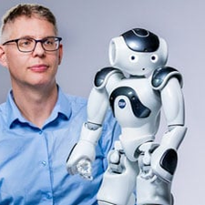
A Brave New World
A.I. – more profound than fire or electricity!
- Sundar Pichai, Alphabet C.E.O.
Mundane Professions to Phase Out
Basic office jobs: Accountants, clerks, tellers, junior lawyers
Junior software & web dev, BPOs, telemarketing & data entry
Basic content writers, proofreaders & graphic designers
Farming, security, factory workers & assembly line
Packagers, drivers, warehousing workers, delivery workers
Experts To Need More AI Skills
Healthcare: Doctors, surgeons, therapists, technicians
Teachers & educationists
Scientists & researchers
Software developers, trade's people, technicians & artists
Corporate strategists, social workers & lawyers
Creative & Innovative Professions To Be In
Artificial intelligence & Machine learning engineers
Data engineers & data scientists
IoT specialists & robotics engineers
Senior software engineers
nodiam – Private & Confidential – 2023 ©

Slide 4
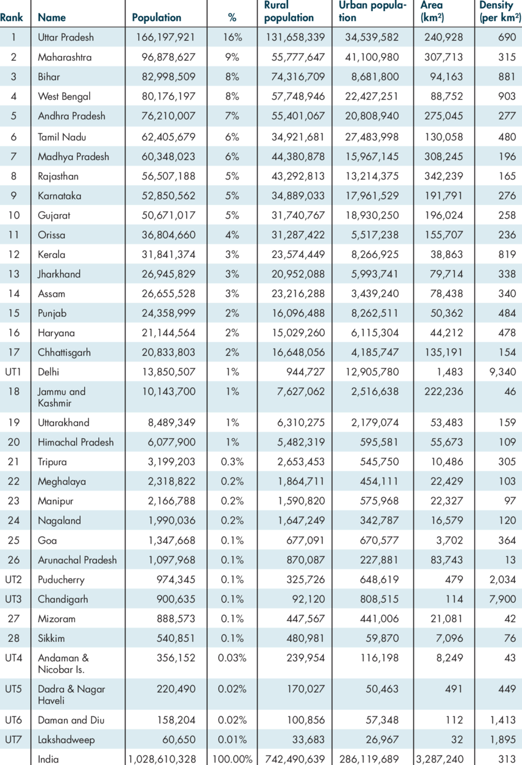
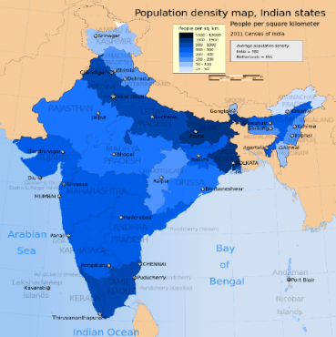

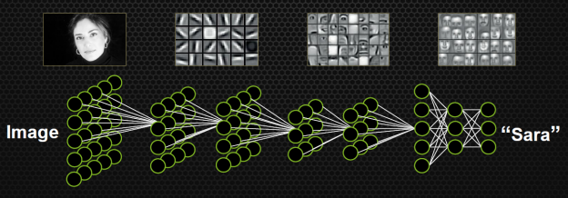
The nodiam Advantage – Python, Data Science & AI
Visualization is key
Visualize the DATA & SCIENCE of data science/AI:
Optimized coding skills
Stimulates interest in otherwise dry subject
Triggers innovation through imagination
Comprehensive training resources
Visual demonstration of how AI actually works internally
Relatable concepts: simplified & delightful
Empathetic & supportive teaching style
Step-by-step, holistic approach
De-clutter the thoughts & inspire to seek further
nodiam – Private & Confidential – 2023 ©

Slide 5

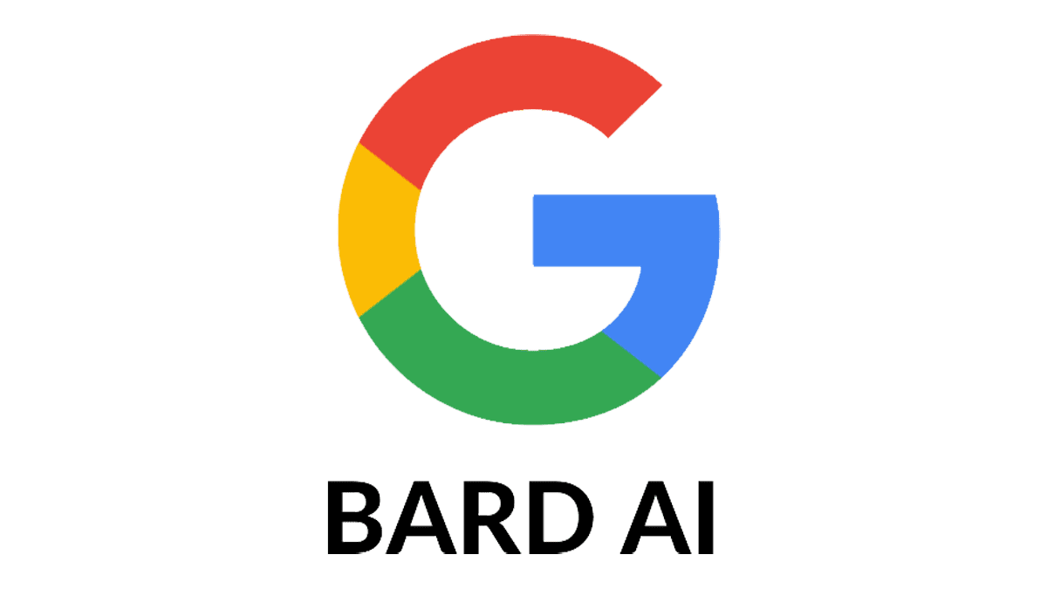


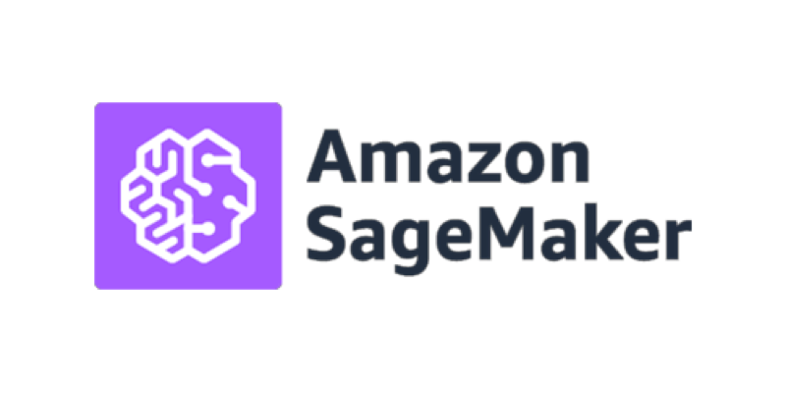
The nodiam Advantage – Demystify Generative AI
Creativity
Deep Learning
Mathematics
Neural Networks
Statistics
Machine Learning
Coding
Data Science
Learn to Leverage Generative AI:
Different models and pipelines
Prompt Engineering
RAG Technique
Langchain, Gradio for AI based apps
Deploy your own chatbot
Exciting NLP projects
nodiam – Private & Confidential – 2023 ©

Slide 6
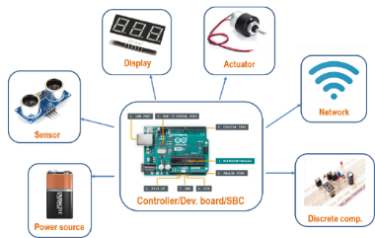
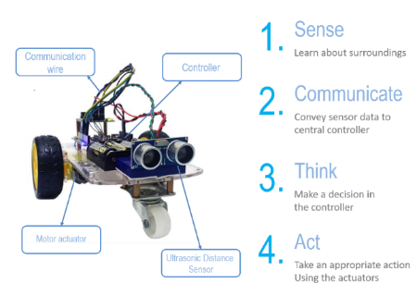
The nodiam Advantage – Robotics & IoT
Robotics Components
At nodiam, we boast our own:
Development boards
Managed IoT cloud platform
Comprehensive training resources
Experiments & Projects
We inspire through hands-on projects:
Comprehensive syllabus coverage
Practical & lucid, help conceptualize
Inspire beyond curriculum to excel in career
nodiam – Private & Confidential – 2023 ©

Slide 7
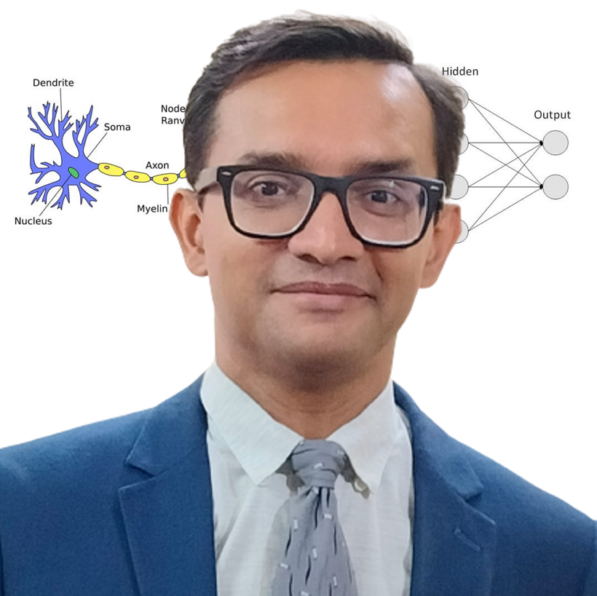
AI & Python Faculty
Anirban Chakrabarty, C.E.O.
B.E.(Electronics), M.B.A. (Finance)
anirban@anodiam.com
Empathetic, Dynamic, & Supportive
24 years of blue-chip experience
Corporate trainer & excellent communications
Dynamo of energy, dependable & trusted for the job! – Vish Coosa, Morgan Stanley, U.S.A.
Thorough Knowledge, Can Make Difficult Concepts in AI Seem Lucid
Worked on multiple Corporate AI projects globally
Elementary thinker, visualizes subject matter through
clutter & noise
Improved accuracy of AI models singlehandedly up to 99.8%
Super brain, the best guy to take care of all our AI implementation!
– Government Client
nodiam – Private & Confidential – 2023 ©

Slide 8

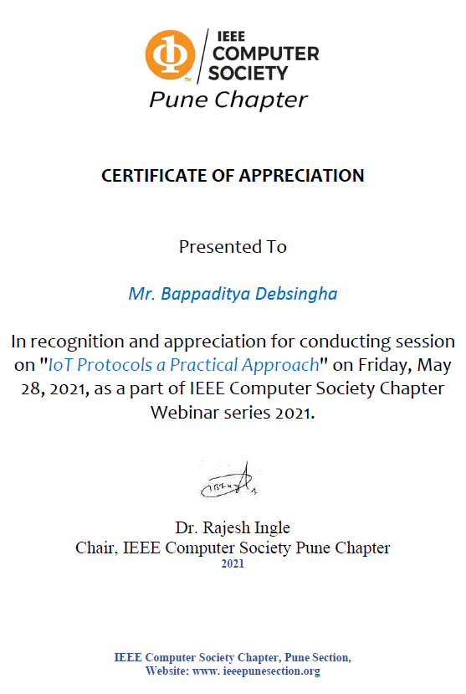
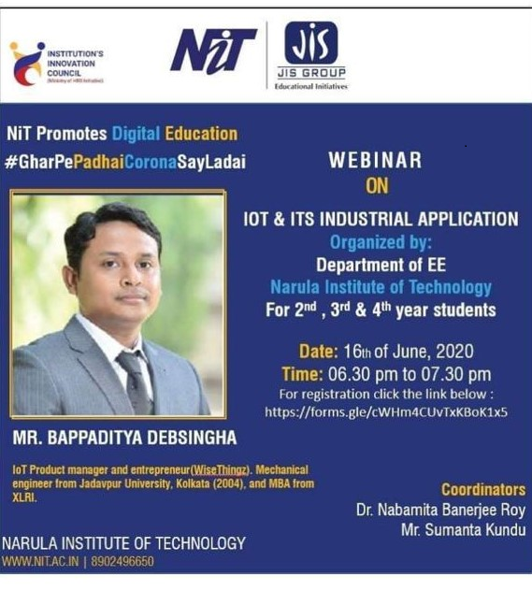
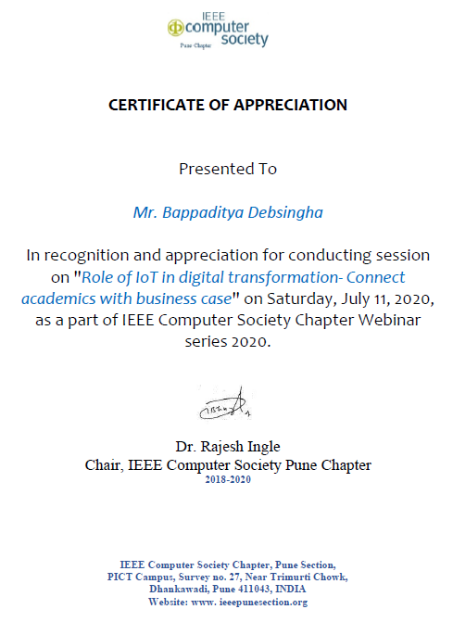
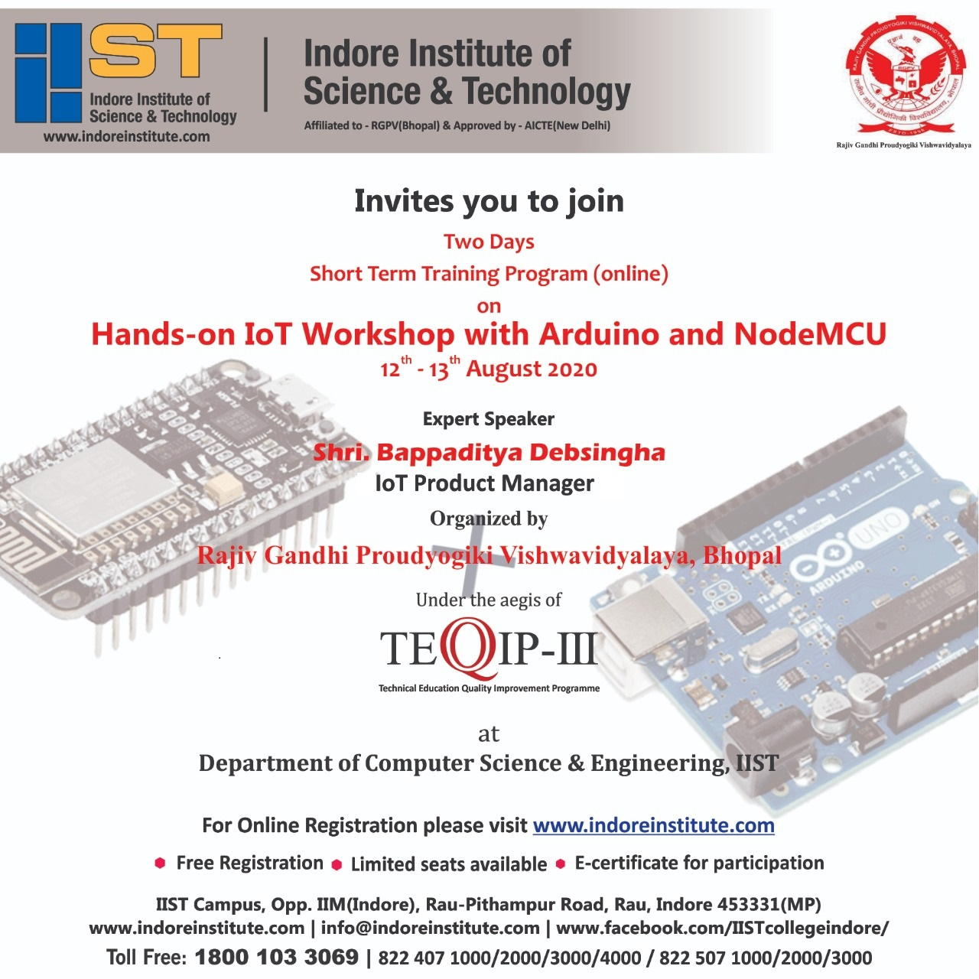
IoT & Robotics Faculty
Bappaditya Debsingha, IoT Prod Manager
B.E.(J.U., Mechanical), M.B.A.(XLRI)
https://www.youtube.com/c/wisethingz
https://www.instagram.com/bappa_wt
www.wisethingz.com
Inspiring Mentor, Innovative & Entrepreneurial
18 years of global experience
Trained hundreds of children & industry professionals
IoT & Robotics workshops at institutions & corporates
Industry Leading S.M.E. in the fields of
Autonomous machines, automation, sensors & IoT driven BI
Analytics dashboards, Cloud API gateways, integration to mobile apps
nodiam – Private & Confidential – 2023 ©

Slide 9

AI & Robotics Bootcamp: Byte Spark 2024
ABSOLUTELY FREE!
2 hours of Workshop and 1 hour orientation
At your facility if more than 50 attendees
at Anodiam conference Hall if less than 50 attendees
Online Webinar if less than 10 attendees
All Teachers, Students and Guardians are welcome!
GRAB BEFORE IT’S GONE!
nodiam – Private & Confidential – 2023 ©

